Slide 1


Chapter Five
Demand for Labour in Competitive Labour Markets
Prepared by Dr. Mir Ahasan Kabir
York University

Slide 2
Learning Objectives
Understand how firms decide how much labour they need to employ to produce a certain amount of goods or services. The theory of labour demand provides the tools required to understand how firms make these decisions.
Labour demand decisions are made both simultaneously with other input decisions and after factories and machines have been built. Learn how do labour demand decisions compare in these two circumstances, that is, in the short versus long run.
Understand why labour demand functions are downward sloping (i.e., decreasing functions of the market wage), and learn that this “law of demand” holds regardless of the time horizon used by the firm in its decisions, or the structure of product market completion.
© 2021 MCGRAW-HILL EDUCATION LTD.
5 - <number>

Slide 3
Learning Objectives
Learn about the factors that affect the elasticity of demand for labour. For example, does it matter whether a firm operates as a monopolist or a perfect competitor in the product market?
Understand the impact of free trade, and of international competition more generally, on the Canadian labour market.
© 2021 MCGRAW-HILL EDUCATION LTD.
5 - <number>

Slide 4
Main Questions
Is there any empirical support for the convention that labour demand functions are downward sloping?
How can we characterize the competitiveness of Canadian labour in an increasingly globalized world economy? How have the productivities and wages of Canadian workers evolved over time compared to the rest of the world? Does this bode well for future employment prospects of Canadian workers?
What is the impact of the Internet and technological change on the demand for labour?
How can we use labour demand functions to assess the impact of offshoring and globalization on the wages and employment of Canadian workers?
© 2021 MCGRAW-HILL EDUCATION LTD.
5 - <number>

Slide 5
Introduction
The demand for labour is necessarily linked to the demand for the goods and services that the labour is used to produce.
For this reason, the demand for Labour is called a derived demand.
Economists usually distinguish between short-run and long-run decisions.
  Short-run: One or more factors of production cannot be varied
  Long-run: Firm can adjust all its inputs—all factors of production are variable factors
© 2021 MCGRAW-HILL EDUCATION LTD.
5 - <number>

Slide 6
Introduction
Demand for labour depends on the firm’s objectives and constraints:
  Objective: Profit Maximization
  Constraints:
    Market structure
    Demand for the product (output)
    Factor prices
    Production function (the maximum output given the various combinations of inputs)
    The decision-making time frame (short run vs. long run)
© 2021 MCGRAW-HILL EDUCATION LTD.
5 - <number>

Slide 7
Introduction
The theory of labour demand examines the quantity of labour services the firm desires to employ given:
    the market-determined wage rate, or
    the labour supply function the firm faces
© 2021 MCGRAW-HILL EDUCATION LTD.
5 - <number>

Slide 8
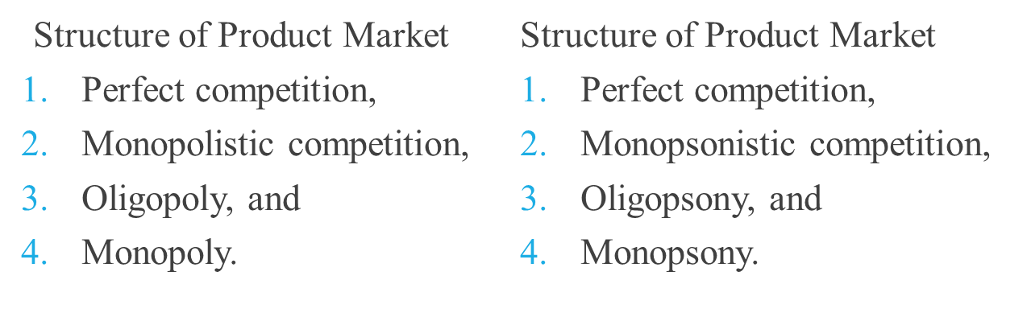
Categorizing the Structure of Product and Labour Markets
The structures of both the output and labour markets influence the demand and supply of labour and, hence, the employment and the wage outcomes.
Categories are independent of each other.
16 possible combinations that affect wage and employment outcomes.
© 2021 MCGRAW-HILL EDUCATION LTD.
5 - <number>

Slide 9
Demand for Labour in the Short Run
Production Function
Assumptions:
Firms use two factors of production
  Labour (N) and
  Capital (K) to produce Q (output)
  Thus, Q = F(K, N)
K is fixed in short run
© 2021 MCGRAW-HILL EDUCATION LTD.
5 - <number>

Slide 10
Demand for Labour in the Short Run
Profit-Maximization
Costs fall into two categories:
  Fixed (sunk cost)
  Variable
Decision Rule #1
Operate if variable costs are covered (i.e., total revenue exceeds or is equal to total variable costs)
© 2021 MCGRAW-HILL EDUCATION LTD.
5 - <number>

Slide 11
Demand for Labour in the Short Run
Decision Rule #2
Increase output until the additional cost associated with the last unit produced (MC) equals the additional revenue associated with that unit (MR), that is:
Marginal Cost equals Marginal Revenue MC = MR
© 2021 MCGRAW-HILL EDUCATION LTD.
5 - <number>

Slide 12
Demand for Labour in the Short Run
Terminology is modified:
  Total Revenue Product (TRP): the total revenue associated with the amount of an input employed
  Marginal Revenue Product (MRP): the change in total revenue associated with a change in the amount of input employed
© 2021 MCGRAW-HILL EDUCATION LTD.
5 - <number>

Slide 13
Demand for Labour in the Short Run
  Firm should produce if the total revenue product generated by the variable input (e.g., labour) exceeds the total costs associated with employing that input, or:
  TRP_{N} > TC_{N}
  Expand employment of labour to the point at which its marginal revenue product equals marginal cost:
  MRP_{N} = MC_{N} = W
© 2021 MCGRAW-HILL EDUCATION LTD.
5 - <number>

Slide 14
Demand for Labour in the Short Run
Characteristics of a firm in a competitive market:
  price taker
  can hire labour without affecting market wage
  marginal (and average) cost is the market wage
  hire labour until the MRP equals the W
  short-run labour demand curve is its marginal revenue product curve
© 2021 MCGRAW-HILL EDUCATION LTD.
5 - <number>

Slide 15
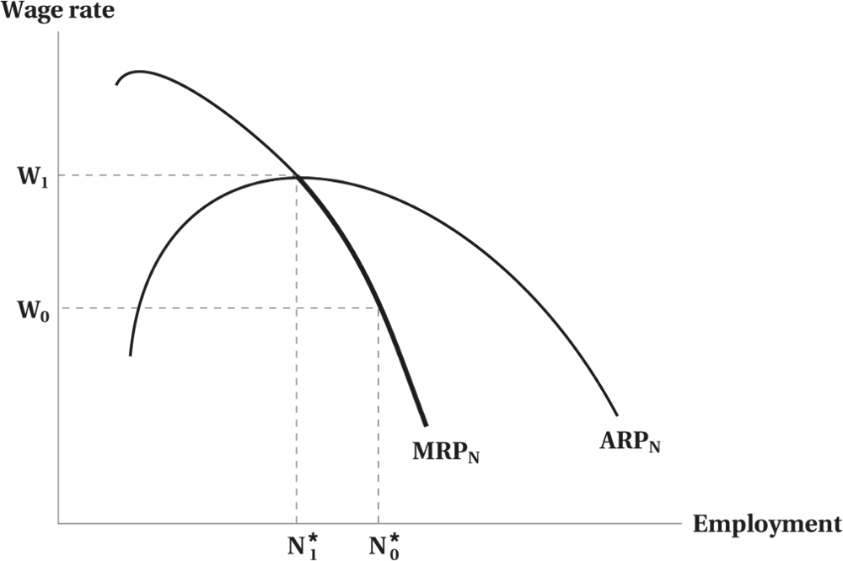
Demand for Labour in the Short Run
Figure 5.1 The Firm’s Short-Run Demand for Labour
© 2021 MCGRAW-HILL EDUCATION LTD.
5 - <number>

Slide 16
Demand for Labour in the Short Run
Firm will shut down:
  If average cost of labour (wage rate) exceeds the average revenue product of labour
Short-run labour demand curve:
  The same as MRP_{N} curve, below the point at which the average and marginal product curves intersect
© 2021 MCGRAW-HILL EDUCATION LTD.
5 - <number>

Slide 17
Demand for Labour in the Short Run
Downward sloping because of diminishing marginal returns to labour
↓ in wage rate will cause ↑ in demand for labour
↑ in wage rate will cause ↓ in demand for labour
© 2021 MCGRAW-HILL EDUCATION LTD.
5 - <number>

Slide 18
Demand for Labour in the Long Run
All inputs are variable - no fixed costs
Isoquants:
“Equal quantity”
Combinations of labour and capital used to produce a given amount of a product (output)
Slope exhibits a diminishing marginal rate of technical substitution (MRTS)
© 2021 MCGRAW-HILL EDUCATION LTD.
5 - <number>

Slide 19
Demand for Labour in the Long Run
Isocost Line:
All combinations of capital and labour that can be bought for a given total cost
TC = rK + wN
Where,
K = capital and N = labour
r = price of capital
w = wage
© 2021 MCGRAW-HILL EDUCATION LTD.
5 - <number>

Slide 20
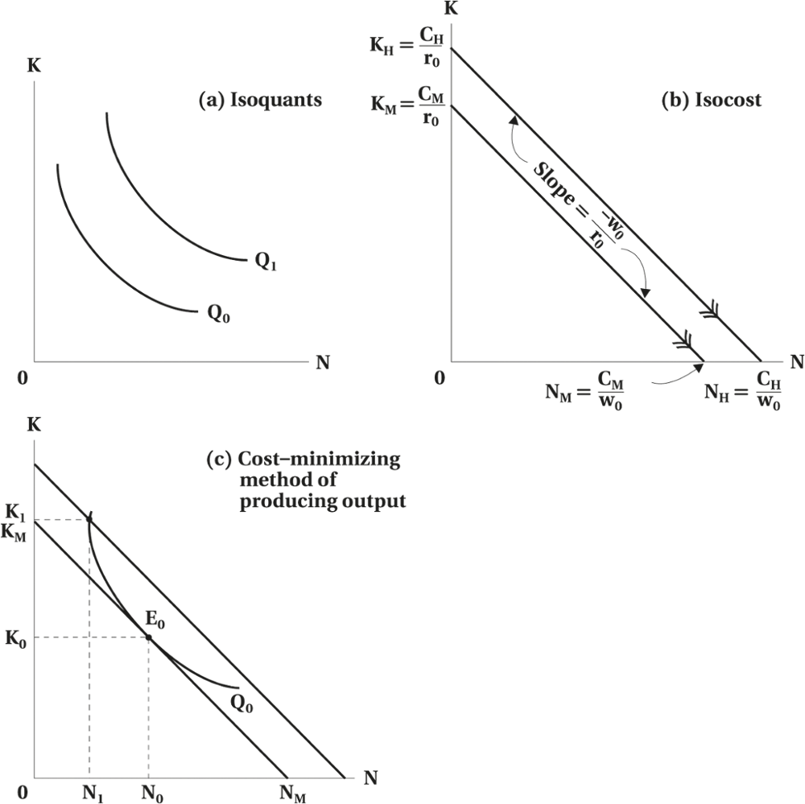
Demand for Labour in the Long Run
Figure 5.2 Isoquants, Isocost, and Cost Minimization
© 2021 MCGRAW-HILL EDUCATION LTD.
5 - <number>

Slide 21
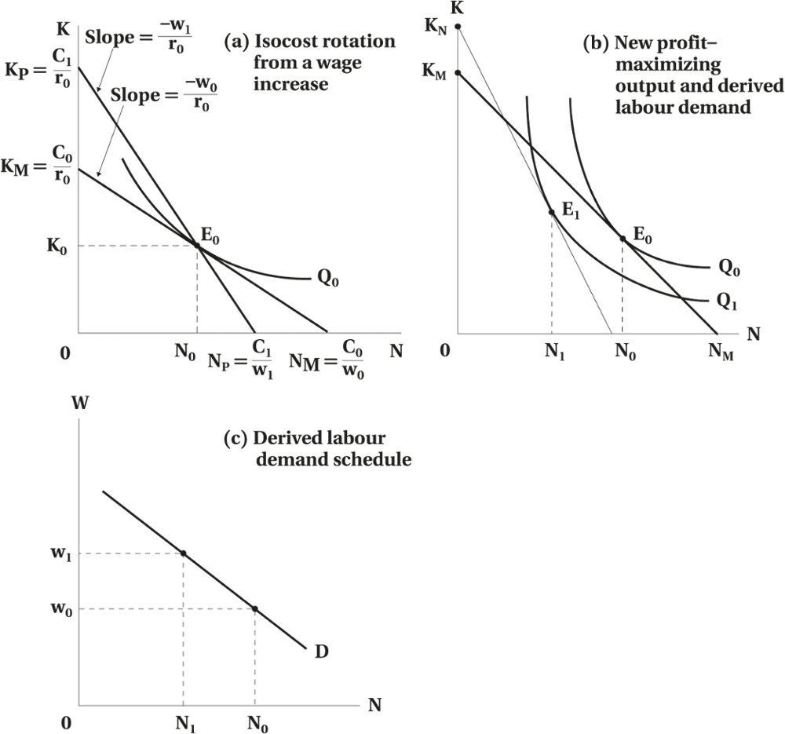
Demand for Labour in the Long Run
Figure 5.3 Deriving the Labour Demand Schedule
© 2021 MCGRAW-HILL EDUCATION LTD.
5 - <number>

Slide 22
Demand for Labour in the Long Run
The Effect of a Cost Increase on Output Under Perfect Competition
Increase in wage rotates isocost line inwards
The firm will maximize profit by reducing the labour and substituting capital for labour
Increase in wage also shifts up the firm's marginal and average cost curves
In a perfect competitive industry, each firm reduces output and raises the price of the product
© 2021 MCGRAW-HILL EDUCATION LTD.
5 - <number>

Slide 23
Demand for Labour in the Long Run
The Effect of a Cost Increase on Output Under Monopoly
Properties:
Single supplier
No close substitute for the product
Price setter
Profit maximization conditions: MR = MC
P > MC
Firm and industry demands are the same
When the monopolist hires more labour to produce more output, both the marginal physical product of labour and the marginal revenue falls
© 2021 MCGRAW-HILL EDUCATION LTD.
5 - <number>

Slide 24
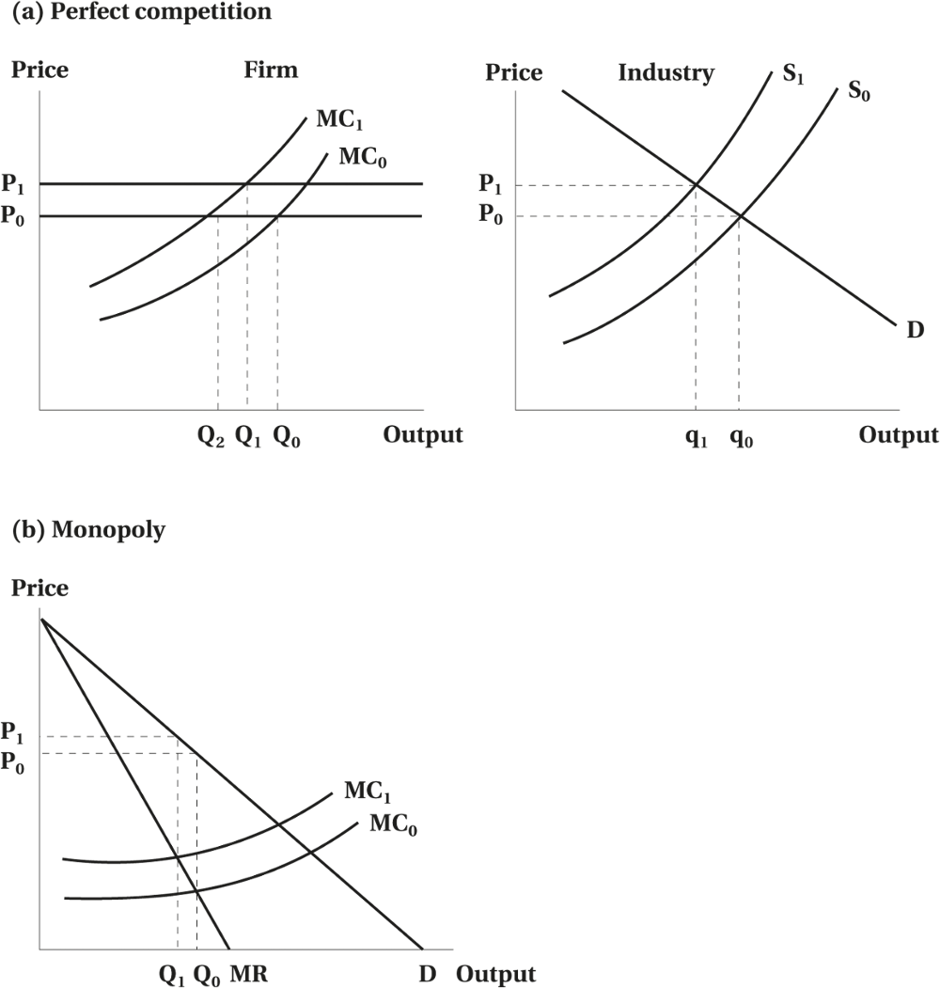
Demand for Labour in the Long Run
Figure 5.4 The Effect of a Cost Increase on Output
© 2021 MCGRAW-HILL EDUCATION LTD.
5 - <number>

Slide 25
Demand for Labour in the Long Run
Substitution Effect
  Firm would substitute cheaper inputs for the more expensive labour:
Scale Effect
  Firm would reduce its scale of operations because of the cost increase associated with the increase in wage:
© 2021 MCGRAW-HILL EDUCATION LTD.
5 - <number>

Slide 26
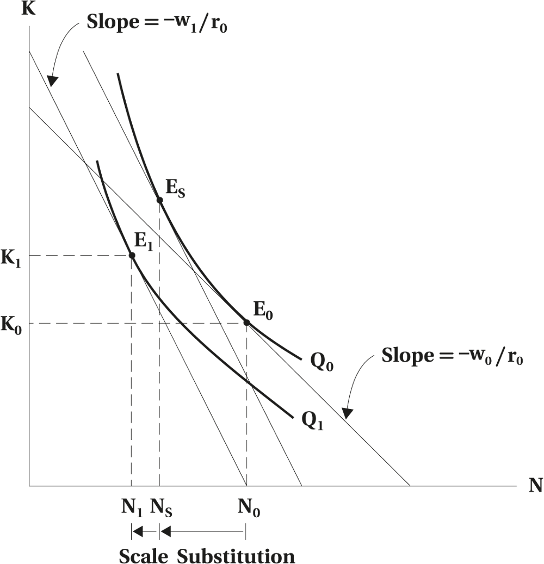
Demand for Labour in the Long Run
Figure 5.5 Substitution and Scale Effects of a Wage Change
© 2021 MCGRAW-HILL EDUCATION LTD.
5 - <number>

Slide 27
Demand for Labour in the Long Run
WORKED EXAMPLE
The Effect of Offshoring on Employment
Consider the case of two firms.
Toy Inc. (Toy) is a toy maker that can either hire workers in Canada or abroad to assemble toys.
Workers are very close substitutes in production.
Outsourcing work abroad reduces Canadian employment.
© 2021 MCGRAW-HILL EDUCATION LTD.
5 - <number>

Slide 28
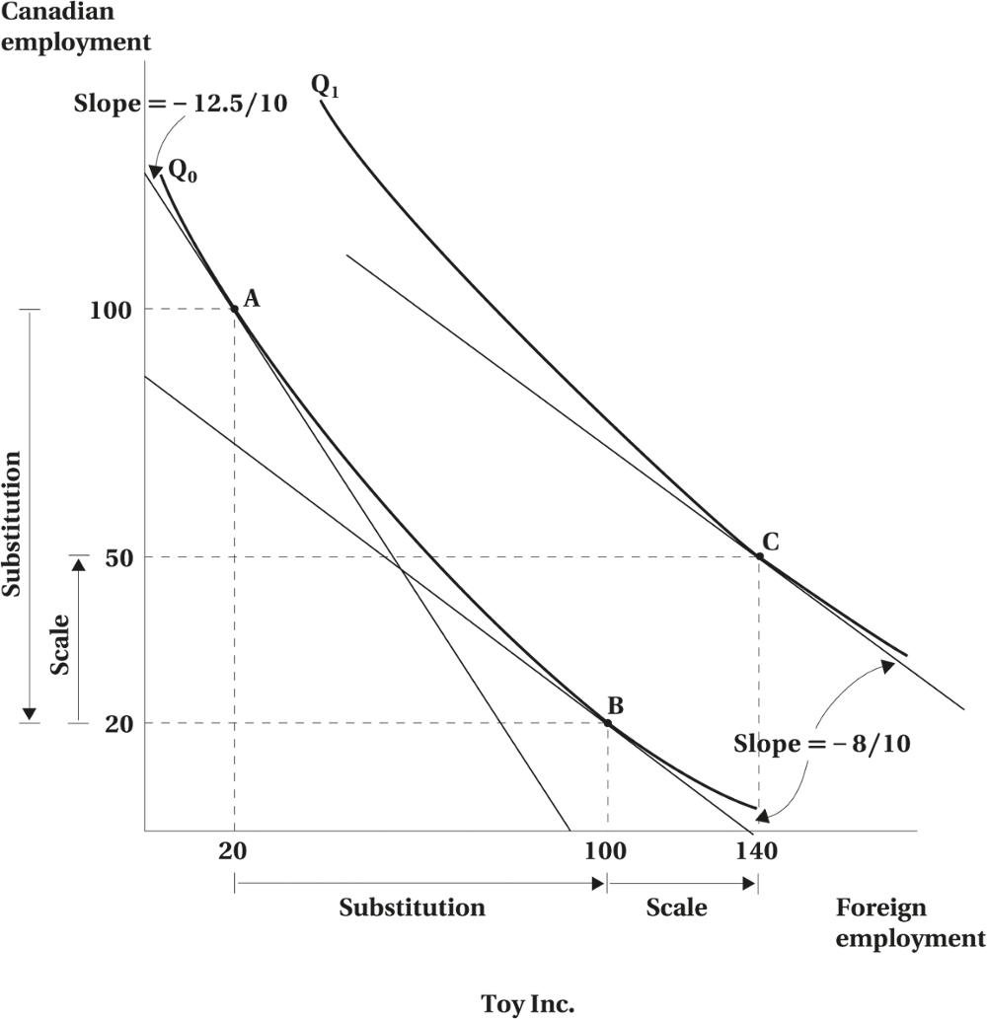
Demand for Labour in the Long Run
Toy Inc.
© 2021 MCGRAW-HILL EDUCATION LTD.
5 - <number>

Slide 29
Demand for Labour in the Long Run
WORKED EXAMPLE
The Effect of Offshoring on Employment
Bridge Inc. (Bridge) - a Canadian engineering firm specialized in building bridges at home and abroad.
Bridge employs very different workers in Canada and abroad.
  All the engineers, designers, and managers work in Canada.
  Construction workers are hired in the country where bridges are being built.
Workers are close complements in Production.
Outsourcing work abroad does not result in decline in Canadian employment.
© 2021 MCGRAW-HILL EDUCATION LTD.
5 - <number>

Slide 30
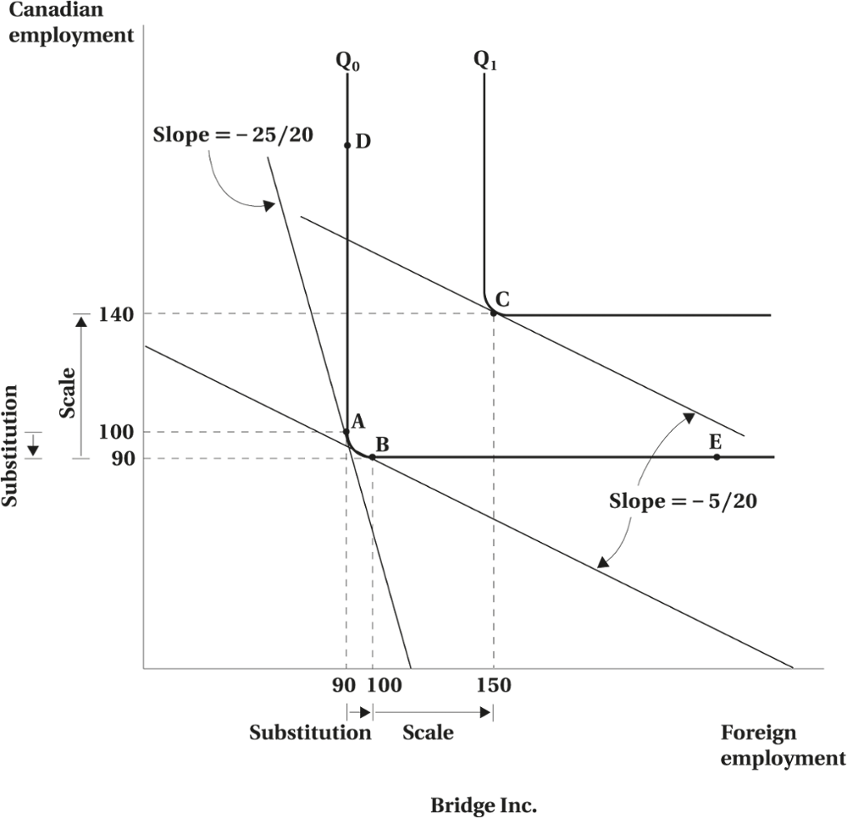
Demand for Labour in the Long Run
Bridge Inc.
© 2021 MCGRAW-HILL EDUCATION LTD.
5 - <number>

Slide 31
The Relationship Between Short- and Long-Run Labour Demand
Short-Run
  Amount of capital is fixed
  No substitution effect
Long-Run
  Firm has flexibility by varying its capital stock
  Response to a wage change will be larger in the long run
© 2021 MCGRAW-HILL EDUCATION LTD.
5 - <number>

Slide 32
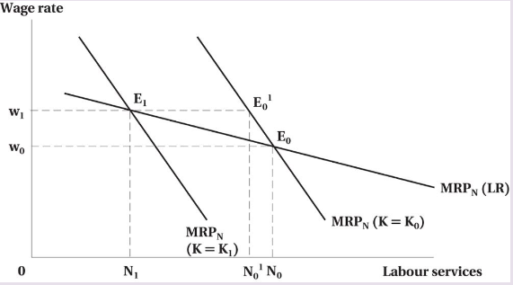
The Relationship Between Short- and Long-Run Labour Demand
Figure 5.6 The Demand for Labour in the Short and the Long Run
© 2021 MCGRAW-HILL EDUCATION LTD.
5 - <number>

Slide 33
Labour Demand under Cost Minimization
Organizations in the public and quasi-public sectors seek to produce given output at minimum cost.
The distinction between the scale and substitution effects is useful in analyzing the demand for labour in these circumstances.
© 2021 MCGRAW-HILL EDUCATION LTD.
5 - <number>

Slide 34
Elasticity of Demand for Labour
Demand for labour decreases as wages increase (negative function).
Wage increases have an adverse effect on employment.
The magnitude of the effect can be seen by the elasticity of the derived demand for labour.
© 2021 MCGRAW-HILL EDUCATION LTD.
5 - <number>

Slide 35
Elasticity of Demand for Labour
Measures the responsiveness of the quantity of labour demanded to the wage rate
Equals the % change in the quantity of labour demanded divided by the % change in the wage rate
© 2021 MCGRAW-HILL EDUCATION LTD.
5 - <number>

Slide 36
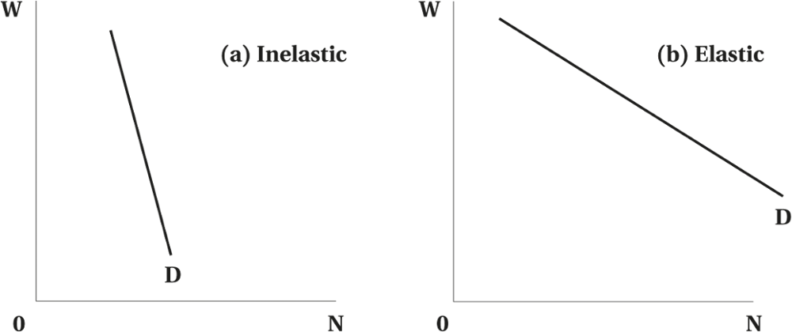
Elasticity of Demand for Labour
Figure 5.7 Inelastic and Elastic Demand for Labour
© 2021 MCGRAW-HILL EDUCATION LTD.
5 - <number>

Slide 37
Elasticity of Demand for Labour
Basic determinants of the elasticity of demand for labour:
  Availability of substitute inputs
  Supply of substitute inputs
  Demand for output
  Ratio of labour cost to total cost
© 2021 MCGRAW-HILL EDUCATION LTD.
5 - <number>

Slide 38
Elasticity of Demand for Labour
If inputs can not be easily substituted, elasticity of labour demand decreases
If demand for output is not affected by a price increase (due to cost of wage increase) demand for labour will be inelastic
Demand for labour will be inelastic if labour cost is small portion of total cost
© 2021 MCGRAW-HILL EDUCATION LTD.
5 - <number>

Slide 39
Changing Demand Conditions, Globalization, and Offshoring
Changing demand conditions
The impact of globalization on domestic employment found in the popular media
  Trans-Pacific Partnership (TPP)
  Offshoring
  Impact of Information and Communication Technologies (ITCs)
© 2021 MCGRAW-HILL EDUCATION LTD.
5 - <number>

Slide 40
Changing Demand Conditions, Globalization, and Offshoring
The Impact of Trade in a Single Labour Market
Will production always move to lower wage countries?
  Canadian and foreign labour may not be substitutes in production.
  Profit-maximization condition involves both sides to the equality: costs and productivity
© 2021 MCGRAW-HILL EDUCATION LTD.
5 - <number>

Slide 41
Changing Demand Conditions, Globalization, and Offshoring
Table 5.1 Productivity,¹ 2000, and Changes in Productivity, Hourly Compensation,² and Unit Labour Costs,³ 2000–2018 (various OECD Countries)
Country | Productivity in 2000 (as % of Canada) | % Change in Productivity | % Change in Compensation | % Change in Unit Labour Costs
Korea | 45 | 99 | 32 | –23
Mexico | 46 | 2 | –44
New Zealand | 79 | 21 | 76 | 42
Japan | 87 | 20 | –38 | –48
Australia | 99 | 24 | 45 | 22
Canada | 100 | 18 | 16 | 1
Spain | 102 | 17 | 18 | –1
United Kingdom | 111 | 18 | –5 | –18
Finland | 116 | 20 | 24 | 5
Italy | 119 | 1 | 14 | 13
Sweden | 121 | 28 | 17 | –7
United States | 123 | 30 | 2 | –19
Germany | 126 | 19 | 9 | –6
France | 129 | 18 | 19 | 6
Netherlands | 135 | 15 | 19 | 3
Denmark | 135 | 22 | 33 | 10
Switzerland | 136 | 19 | 40 | 19
Belgium | 143 | 14 | 21 | 5
Norway | 164 | 16 | 46 | 27
Average | 111 | 22 | 18 | 2
© 2021 MCGRAW-HILL EDUCATION LTD.
5 - <number>

Slide 42
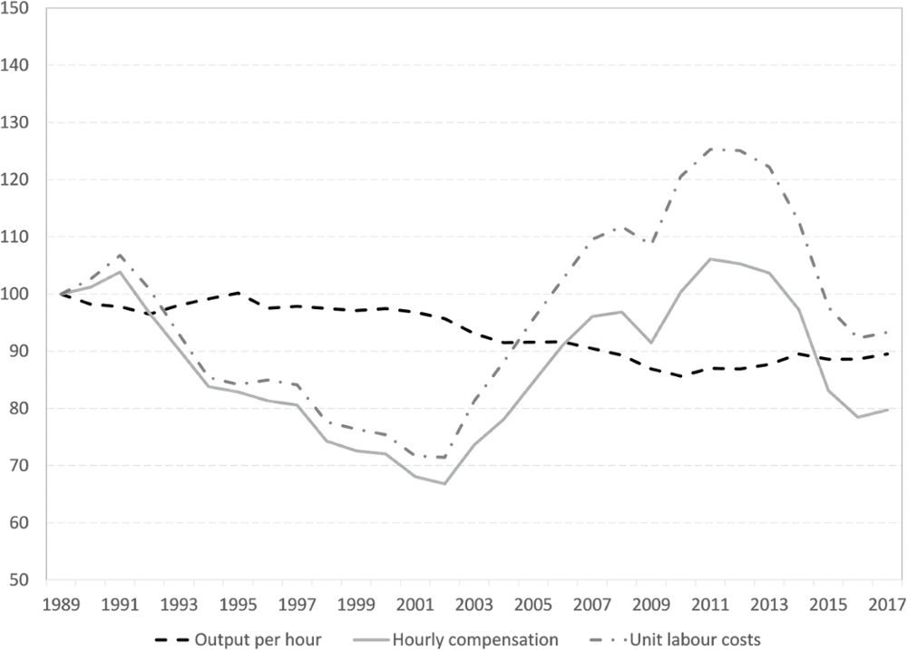
Changing Demand Conditions, Globalization, and Offshoring
Figure 5.8 Relative Trends in Labour Costs and Productivity: Canada Relative to the United States (base year 1989)
© 2021 MCGRAW-HILL EDUCATION LTD.
5 - <number>

Slide 43
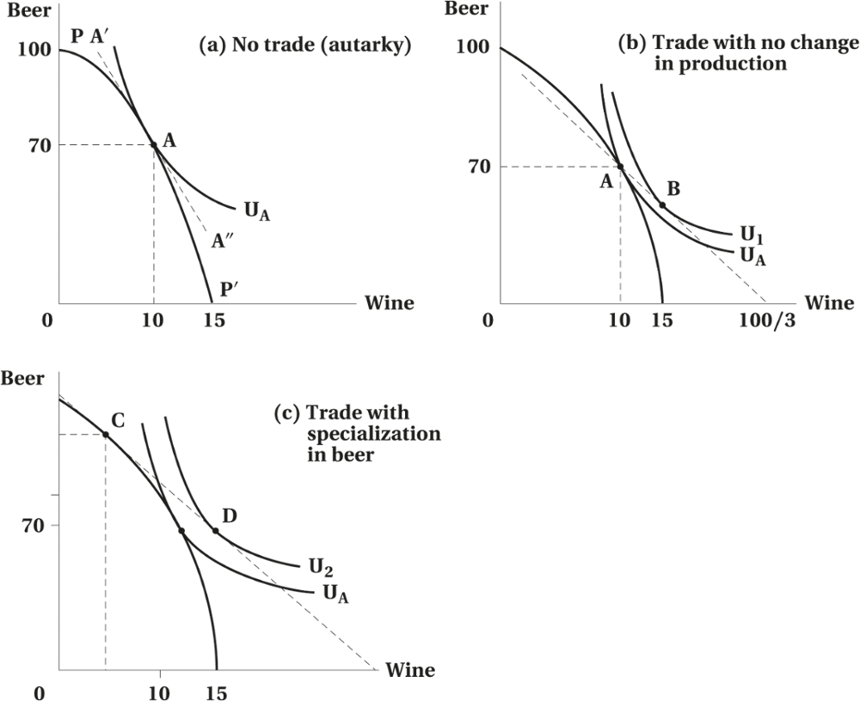
Changing Demand Conditions, Globalization, and Offshoring
Figure 5.9 Trade, Consumption, and Production in a Simple Economy
© 2021 MCGRAW-HILL EDUCATION LTD.
5 - <number>

Slide 44
Changing Demand Conditions, Globalization, and Offshoring
Evidence
The Impact of CUFTA and NAFTA
  Short-run adjustment costs
  Significant long-run benefits of the FTA
  Impact of offshoring has been modest.
© 2021 MCGRAW-HILL EDUCATION LTD.
5 - <number>

Slide 45
Changing Demand Conditions, Globalization, and Offshoring
Other Demand-Side Factors
“Declining Middle” and Wage Polarization
“Smokestack” Industries move towards more-flexible, modular factories.
ICTs dramatically reshaped the internal organization of firms and business practices.
© 2021 MCGRAW-HILL EDUCATION LTD.
5 - <number>

Slide 46
Chapter Summary
Derived Labour Demand
Firm’s Profit Maximization and Labour Demand:
  Short Run: W = MRP
  Long Run: Factor Substitution, Substitution Effect and Scale Effect
Labour Demand Curve
The Impact of Globalization and Outsourcing
© 2021 MCGRAW-HILL EDUCATION LTD.
5 - <number>

